Slide 1
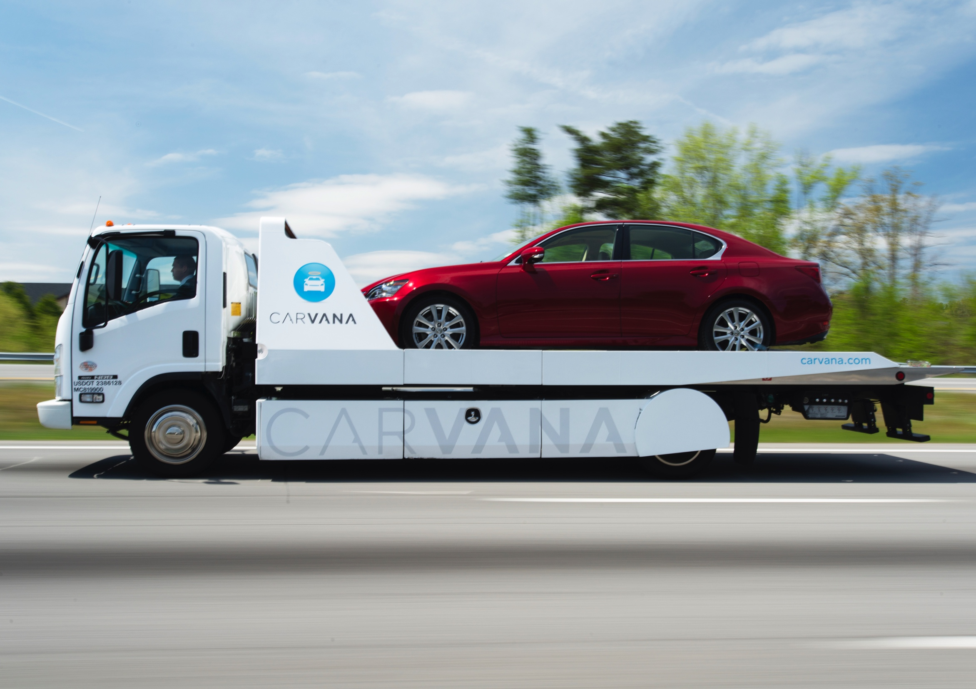
Angular 2 Universal
David Fye, Front-End Architect
July 13, 2016

Slide 2

Our Roadmap
CARVANA
Angular 1
Angular 2 +
Universal
Asp.net/Razor
Knockout/
jQuery

Slide 3
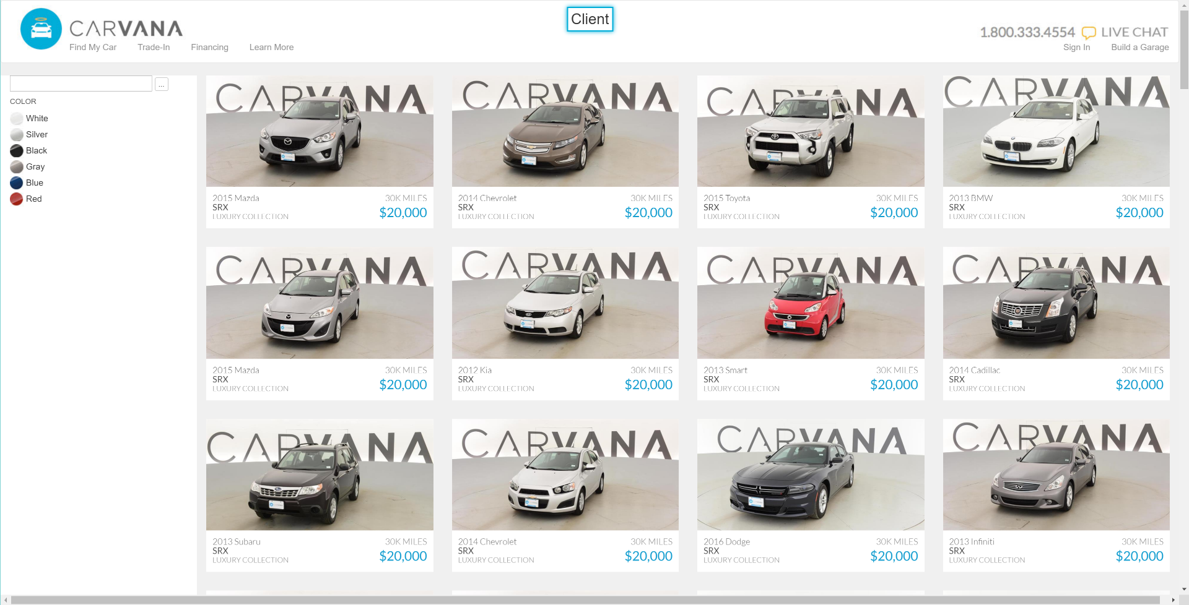
Angular SPA Example
CARVANA

Slide 4
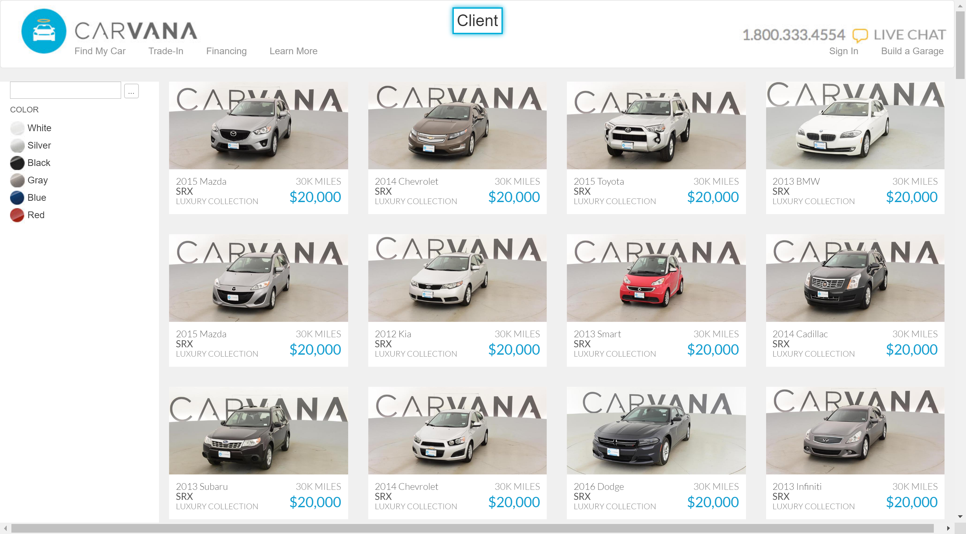
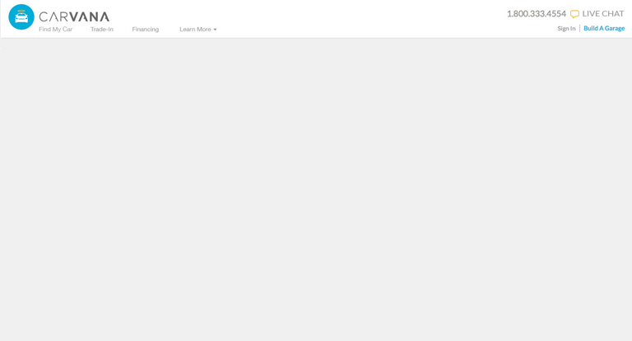

What are we trying to solve?
CARVANA
What
We See
Search Engine
Optimization
Rich Social
Embedding
What Some
Crawlers
See
Not all search engines perfectly support SPAs

Slide 5
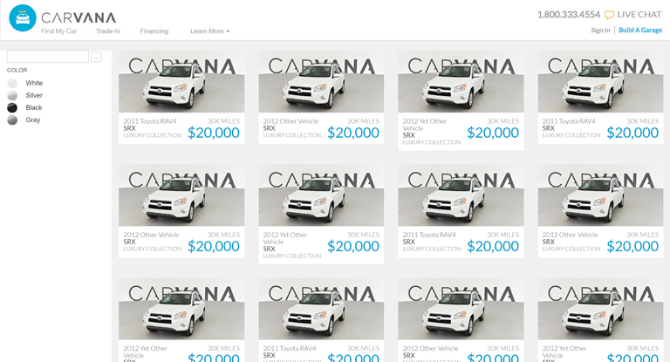

What are we trying to solve?
CARVANA
Performance
(Page Render)
First
Render
After
Angular
Bootstrapped
Abandoned at 3 seconds average!

Slide 6
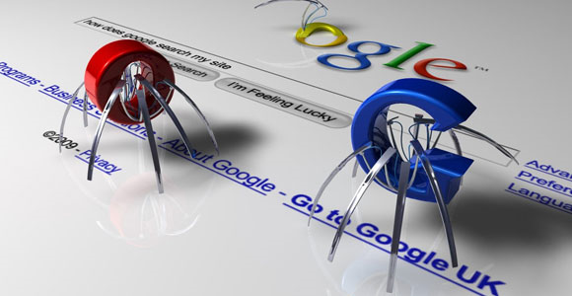

Solutions?
CARVANA
Smarter Crawlers
When will this happen?
How long will they wait for JavaScript requests?
Can we afford to depend on the various crawlers to implement?

Slide 7
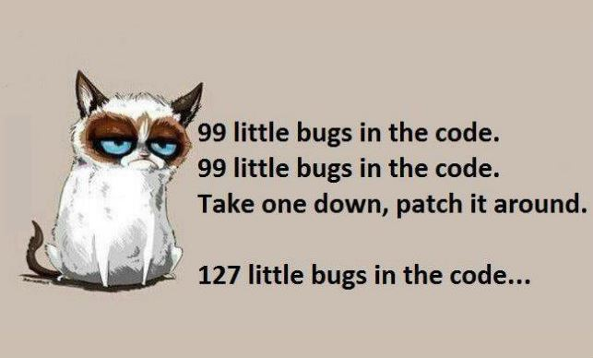
Solutions?
CARVANA
Static Files
Duplication/Code bloat
Potential bugs

Slide 8
Solutions?
CARVANA
Server-rendered
SEO
Performance
Single codebase

Slide 9


Angular 2 Universal
CARVANA
Server render
Client Code === Server Code
Better SEO
Multiple Platforms
Release Candidate 4
5x faster than Angular 1
10k smaller than Angular 1

Slide 10
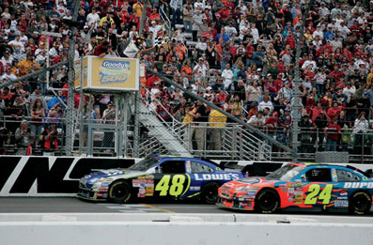
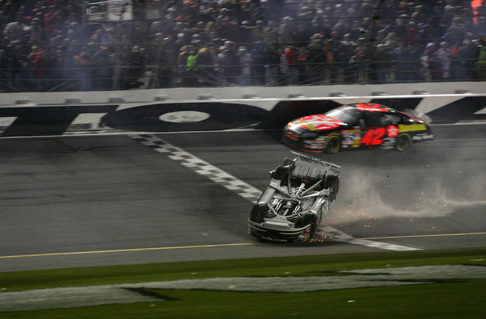
Ready or Not?
CARVANA
Server rendering
Seamless client interaction
Single http call
Routing

Slide 11

Demo
CARVANA
Angular 2 QuickStart
Angular 2 RC4
Webpack
Express
Http call

Slide 12

Summary
CARVANA
SEO
Performance
Single codebase
Repository
Github “fydoh”
https://github.com/fydoh/phoenix-js-meetup

Slide 13
Resources
CARVANA
Angular QuickStart
https://angular.io/docs/js/latest/quickstart.html
Webpack
https://angular.io/docs/ts/latest/guide/webpack.html
SEO for SPAs further reading
https://gofishdigital.com/angularjs-single-page-app-seo/
Kissmetrics performance analysis
https://blog.kissmetrics.com/speed-is-a-killer/
ngConf resources
https://scotch.io/bar-talk/the-best-news-from-angulars-ng-conf-2016
Github HTTP issue
https://github.com/angular/universal-starter/issues/62
https://github.com/angular/universal/issues/271

Slide 14

Thank You

